Slide 1







Salesforce Solutions for Aetna: Addressing Key Challenges
A comprehensive project pitch deck for Salesforce tailored to Aetna's needs.
Vipin Choudhary

Slide 2




Introduction to Salesforce Solutions for Aetna
Salesforce Solutions for Aetna: Addressing Key Challenges
1
Introduction to Salesforce
An overview of Salesforce's capabilities and its role in business.
2
Key challenges faced by Aetna
Identifying the main challenges Aetna encounters in its operations.
3
Salesforce product suite overview
A detailed look at the various products offered by Salesforce.
4
Enhancing customer experience
Strategies for using Salesforce to improve customer interactions.
5
Driving growth
How Salesforce solutions can facilitate growth for Aetna.
6
Strategic partnership for digital transformation
Exploring the benefits of partnering with Salesforce for digital change.

Slide 3










Understanding Aetna's Key Challenges
Salesforce Solutions for Aetna: Addressing Key Challenges
Data Silos
Customer Engagement
Operational Efficiency
Regulatory Compliance
Fragmented data across various departments leading to inefficiencies.
Difficulty in maintaining consistent and personalized communication with members.
Need for streamlined processes to reduce time and cost.
Ensuring compliance with healthcare regulations and data security standards.

Slide 4
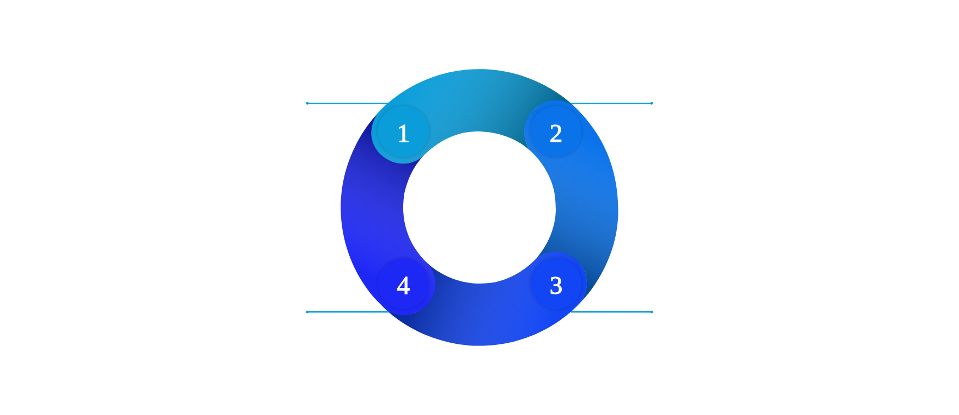
Overview of Salesforce Solutions
Salesforce Solutions for Aetna: Addressing Key Challenges
Salesforce Health Cloud
Salesforce Marketing Cloud
Centralizes patient data, providing a comprehensive 360-degree view of each member.
Enables personalized and targeted communication for improved engagement and retention.
Tableau
Salesforce Service Cloud
Powerful data visualization and analytics tools to drive informed decision-making processes.
Enhances customer service with AI-driven insights and automation for faster resolutions.

Slide 5

Salesforce Health Cloud: Transforming Patient Management
Solutions for Aetna: Addressing Key Challenges in Patient Care
Unified Patient Profiles
Consolidates medical records, treatment plans, and interaction history for comprehensive views.
Secure Data Management
Ensures compliance with HIPAA and other regulations, safeguarding patient information.
Care Coordination
Streamlines communication among healthcare providers to enhance collaboration and efficiency.

Slide 6



Enhancing Customer Engagement with Salesforce Marketing Cloud
Utilizing AI and Multi-Channel Strategies for Effective Outreach
Targeted Campaigns
Use AI to segment and target specific member groups, ensuring personalized communication.
Analytics and Reporting
Multi-Channel Engagement
Measure campaign effectiveness and track member engagement to refine strategies.
Reach members via various platforms including email, SMS, and social media for broader impact.

Slide 7











Improving Service Delivery with Salesforce Service Cloud
Salesforce Solutions for Aetna: Addressing Key Challenges
Case Management
AI-Powered Insights
Omni-Channel Support
1
2
3
Efficiently manage member inquiries and issues to enhance service delivery.
Leverage AI technology to predict and proactively resolve member issues.
Provide seamless support across multiple channels such as phone, email, and chat.

Slide 8







Leveraging Tableau for Data-Driven Decisions
2
Real-Time Analytics
Empowering Aetna's Strategic Initiatives through Advanced Analytics
Access up-to-date information for timely decisions, ensuring Aetna remains agile and informed.
1
Interactive Dashboards
Visualize complex data for actionable insights, enabling quick understanding and decision-making.
3
Custom Reports
Generate reports tailored to specific needs and metrics, enhancing clarity and relevance of data presentations.

Slide 9





Regulatory Compliance
Enhanced Efficiency
Robust security measures ensure compliance with healthcare regulations, protecting sensitive data.
4
1
Streamlined operations reduce costs and time, leading to better productivity.
Key Benefits for Aetna
Salesforce Solutions for Aetna: Addressing Key Challenges
Improved Member Experience
Better Decision-Making
Data-driven insights facilitate strategic planning and informed choices.
3
2
Personalized and consistent communication enhances member satisfaction.

Slide 10




Proposed Implementation Timeline for 2024
Strategic phases for Salesforce Solutions at Aetna
Q1 2024
Q2 2024
Q3 2024
Q4 2024
Planning and requirements gathering.
Initial setup and configuration of Health Cloud and Marketing Cloud.
Integration with existing systems and data migration.
Training, testing, and full deployment.
Initiate the project with comprehensive planning and gather all necessary requirements to ensure alignment with Aetna's needs.
Conduct training sessions for staff, comprehensive testing of the system, and proceed with the full deployment of Salesforce solutions.
Configure and set up the Health Cloud and Marketing Cloud systems to prepare for integration and migration.
Execute the integration of Salesforce with Aetna's existing systems, along with data migration to ensure seamless functionality.

Slide 11

Next Steps for Aetna
Salesforce Solutions for Aetna: Addressing Key Challenges
Schedule a Discovery Call
Develop a Custom Proposal
Discuss specific needs and objectives.
Tailor solutions to Aetna's requirements.
Conduct a Workshop
Kick-off the Project
Identify key areas for improvement and potential solutions.
Initiate the implementation plan and begin the transformation journey.

Slide 12






Unlock the Power of Salesforce for Aetna
Discover innovative solutions tailored for Aetna's success.

